Slide 1

Intermediate Code Generation

Slide 2
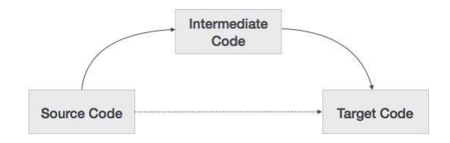
About…
This is the fourth phase in the process of compilation.
This phase receives the syntax directed translated constructs and represents them as intermediate code.

Slide 3
Types
Postfix
Syntax tree
Three address code

Slide 4
(1) Postfix
Also known as Reverse Polish Notation
The infix way of representing the sum of ‘a’ and ‘b’ is with the operator in the middle ‘a+b’
The postfix way of representing the same expression is moving the operator to the right end.
(eg)
‘ab+’

Slide 5
Examples
(a+b) * c
ab+c*
a*(b+c)
abc+*
(a+b) * (c+d)
ab+cd+*

Slide 6
Syntax Directed Translation to Postfix Code
E.CODE is a string valued translation
Production | Semantic Action
E → E⁽¹⁾ op E⁽²⁾ | E.CODE := E⁽¹⁾.CODE || E⁽²⁾.CODE || ‘OP’
E → (E⁽¹⁾) | E.CODE := E⁽¹⁾.CODE
E → id | E.CODE := id

Slide 7
Implementation of infix to postfix translation
Production | Program Fragment
E → E⁽¹⁾ op E⁽²⁾ | {print op}
E → (E⁽¹⁾) | {}
E → id | {print id}

Slide 8
(2) Syntax Trees
The parse tree is also a useful intermediate representation, but it contains redundant information.
One such variant of parse tree is syntax tree.
In a syntax tree, each leaf represents an operand and each interior node, an operator.

Slide 9
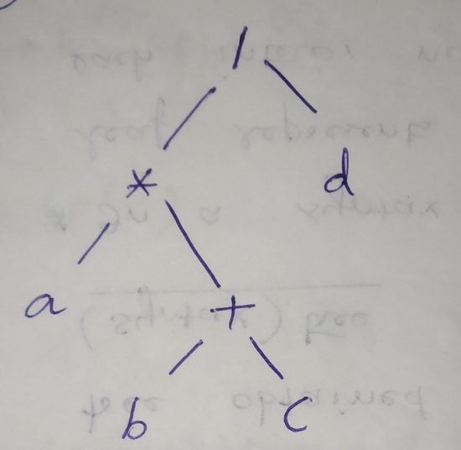
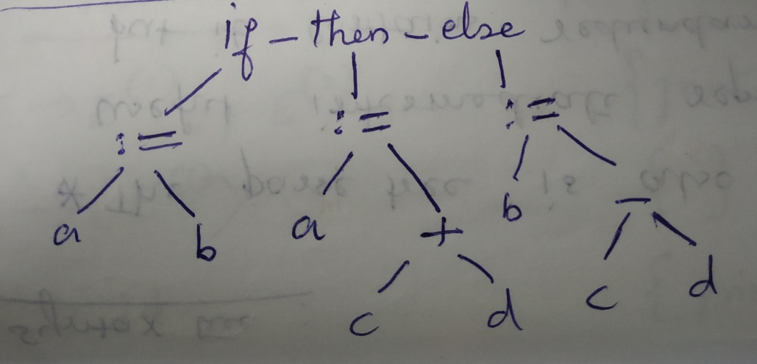
If a:=b then a:=c+d else b:=c-d
a* (b+c) /d

Slide 10
Syntax Directed Construction
E.val is a translation whose value is a pointer to a node in the syntax tree.
Production | Semantic Action
E → E⁽¹⁾ op E⁽²⁾ | {E.val := NODE (OP, E⁽¹⁾ .val, E⁽²⁾ .val)}
E → (E⁽¹⁾) | {E.val := E⁽¹⁾ .val}
E → -E⁽¹⁾ | {E.val := UNARY (-, E⁽¹⁾ .val)}
E → id | {E.val := LEAF(id)}

Slide 11
(3) Three address code
This is the most popularly used method.
General format
x := y op z
where x, y, and z are names, constants, or compiler-generated temporaries;
op stands for any operator such as a fixed- or floating-point arithmetic operator or a logical operator on Boolean valued data.
(eg)
i := i + j + k
Ans:
t₁ = i + j
i = t₁ + k

Slide 12
Types of Three Address Statements
Assignment statements of the form x=y op z ,where op is a binary arithmetic or logical operation.
Assignment instructions of the form x = op y. where op is a unary operation.
Essential unary operations include unary minus.
Logical negation, shift operators and conversion operators that, for example.
convert fixed-point number to a floating-point number.
Copy statement of the form x=y where the value of y is assigned to x.
The unconditional jump goto L.
The three-address statement with label L is the next to be executed.

Slide 13
Conditional jumps such as If x relop y goto L. This instruction applies a relational operator(,>=,etc.) to x and y.
executes, the statement with label L next if x stands in relation relop to y.
If not, the three-address statement following if x relop y goto L is executed next,, as is the usual sequence.
Param x and call p, n for procedure calls and return y.
where y representing a returned value is optional Their typical use it as the sequence of three.address statements param x1 param x2 …. param xn call p,n generated as part of a call of the procedure p(x1,x2,….xn)

Slide 14
Indexed assignments of the form x=y[i] and x[i]=y.
The first of these sets x to the value in the location i memory units beyond location y.
The stat[i]=y sets the contents of the location I units beyond x to the value of y. In both these instructions, x, y. and i refer to data objects.
Address and pointer assignments of the form x=&y, x=*y and *x=y

Slide 15
Implementation of three address code
A three-address statement is an abstract form of intermediate code.
In a compiler, these statements can be implemented as records with fields for the operator and the operands.
Types
Quadruple
Triple
Indirect Triple

Slide 16
Quadruple
A quadruple is a record structure with four fields, which we call op,. arg1, arg 2, and result.
The op field contains an internal code for the operator.
The three-address statement x =y op z is represented by placing y in arg1, z in arg2, and x in result.
Statements with unary operators like x = -y or x= y do not use arg2.

Slide 17
Triple
To avoid entering temporary names into the symbol table, we might refer to a temporary value by the position of the statement that computes it.
Doing so ,the three address statements can be represented by records with only three fields :op,arg1,arg2.
The contents of fields arg1,arg 2, and result are normally pointers to the symbol-table entries for the names represented by these fields.
If so, temporary names must be entered into the symbol table as they are created.

Slide 18
Indirect Triples
Another implementation of three address code that has been considered is that of listing pointers to triples, rather than listing the triples themselves.
This implementation is called indirect triples.

Slide 19
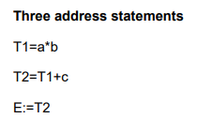
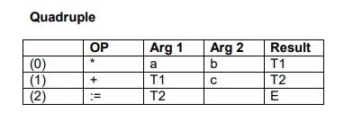
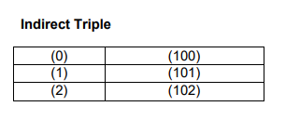
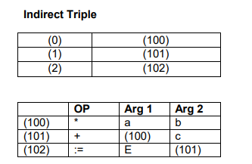
E:=(a*b)+c

Slide 20
Thank You

